Slide 1
Tuberculosis Vaccine
Development
Videlis Nduba, MBchB, MPH, PhD
Senior Principal Clinical Research Scientist-CRDR/KEMRI
29 September 2025

Slide 2
End TB strategy
The End TB strategy advocates for a multi-faceted strategy that includes introducing new tools. These include:
1) a pre exposure vaccine that protects all ages not yet infected with TB from getting TB disease and also prevent latently infected people progressing to disease;
2) highly sensitive diagnostic tests for all TB implementable at the point of care; and
3) Effective, shortened and non-toxic drug regimens that can also treat MDR-TB.

Slide 3
TB will not be eliminated by 2050 with current tools

Slide 4
Projected acceleration of TB incidence decline to target levels

Slide 5
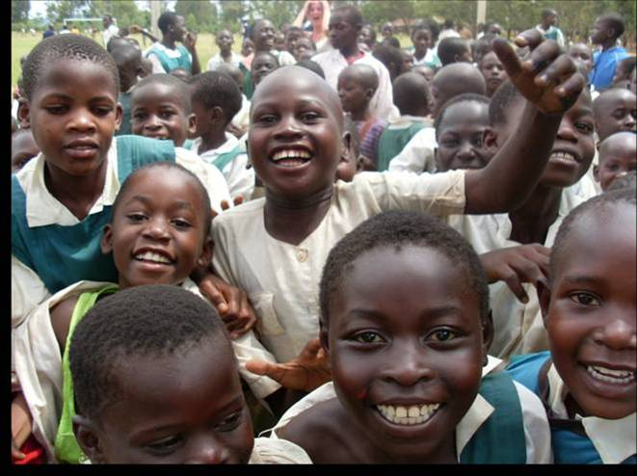
TB STUDIES-ADOLESCENTS
5004 adolescents enrolled
Objective: determine TB incidence and prevalence in adolescents in preparation for TB vaccine trials
TB suspects identified through:
History of household TB contact
Clinical history
Tuberculin skin tests (TST), considered positive when:
≥10mm if HIV negative
≥5mm if HIV positive

Slide 6
Results
Among 4934 adolescents without tuberculosis at baseline, 26 tuberculosis cases were identified during follow up with a corresponding incidence density of 4.4 (95% CI, 3.0-6.4) events per 1000 person years of observation
12 definite tuberculosis cases; incidence density of 2.0 (95% CI, 0.9-3.1).
Having previous tuberculosis (RR= 12.5, CI 1.8, 100) and presence of TST conversion (RR=3.4, CI 1.5, 7.7) were significantly associated with higher risk of tuberculosis
LTBI rate
Year/site LTBI Annual risk of TB infection sample size Age
2004-2007/Nairobi 22% 2.7% 11865 6-14 years
2004-2007/Siaya 14% 1.5% 7411 6-14 years
2008-2009/Siaya 32% 2.6% 5004 12-18 years

Slide 7
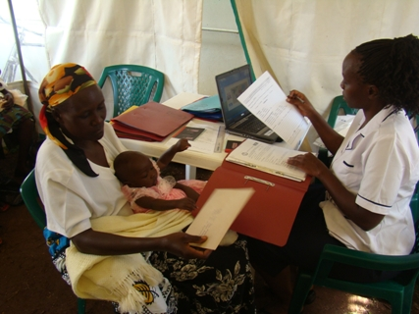
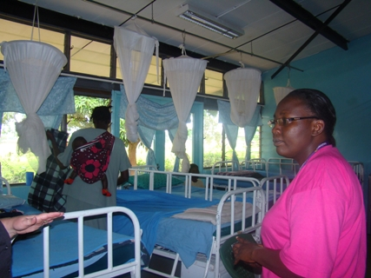
TB STUDIES-INFANTS
2900 infants enrolled and vaccinated with BCG
Objective: determine TB incidence in infants in preparation for vaccine trials
Diagnostic workup
History / examination
Tuberculin testing
Chest radiographs
HIV test
Gastric washings and induced sputa
Speciation of positive cultures to exclude BCG and NTM disease

Slide 8
Results
We observed a high TB incidence among infants in Western Kenya of 1.5(95% CI, 1.1, 2.0) events per 100 person years of observation (PYO)
Majority of the TB cases 40/49 (81.6%) were clinically diagnosed speaking to the challenges of infant TB diagnosis where the tendency is to have paucibacillary disease
Only 9/49 of the TB cases were identified as definite TB cases

Slide 9
Benefits of the EPI studies for Trials
Provided a ready pool of highly trained staff
Ready Infrastructure- clinical, pharmacy and laboratory
Established networks and inroads into community, paving way for vaccine trials to be accepted
Forged referral links with health facilities vital for the trials success

Slide 10
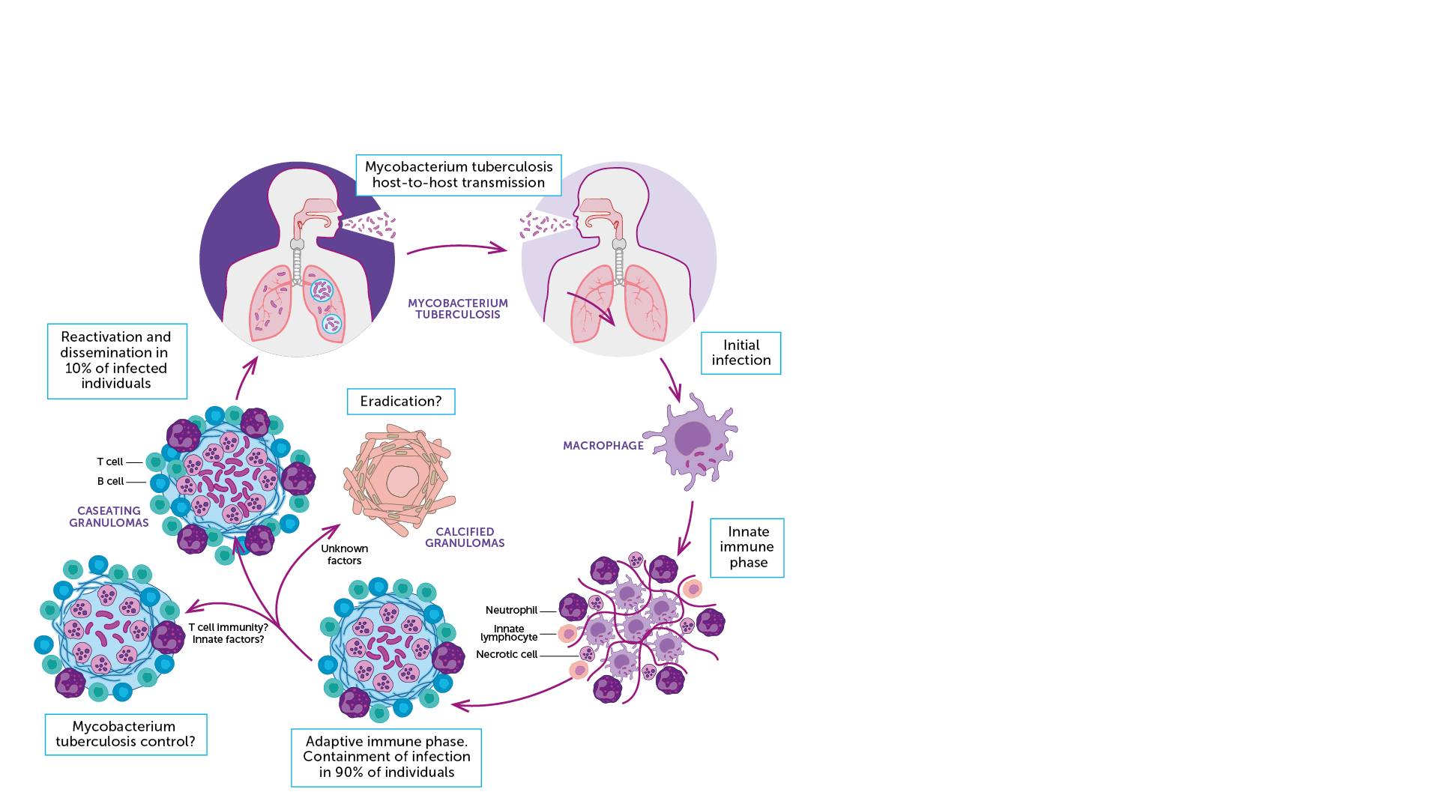
TB and the Immune System
The interaction between the immune system and Mycobacterium tuberculosis are complex and either lead to:​
Clearance of the bacteria​
Latent TB infection​
Active TB disease ​​
M.tb can prevent the activation of pathogen destruction systems within macrophages where it can hide, reproduce slowly, and modify the cell to its advantage.​
M.tb can affect the function of dendritic cells by altering the production of various cytokines involved in the immune responses and the suppression of T lymphocyte activity.​
M.tb can also interfere with the interactions between the different cells of the immune system and hamper their ability to work together and kill or constrain the organism.​

Slide 11


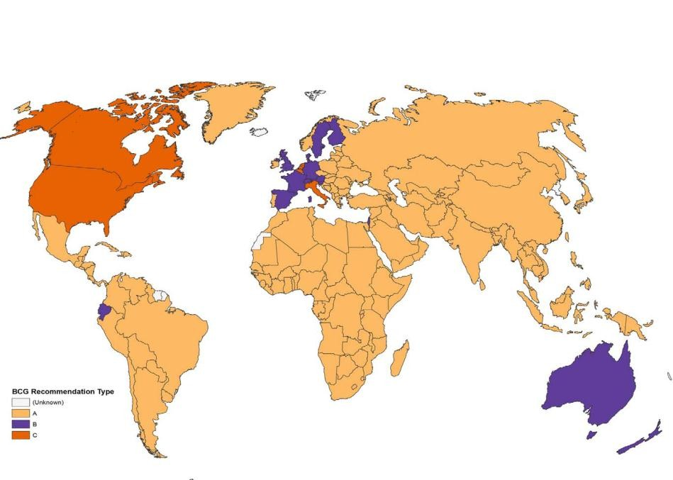
Vaccine development:
Why BCG is not good enough
background
Live attenuated M. bovis, first used in 1921
BCG protects against severe meningitic and
miliary TB in infants and children (RR 0.15)
Billions of doses administered to infants since
1970’s
1921 Model T Ford
Offers only partial protection against pulmonary
TB in children
Little or no protection against pulmonary TB in adults
Meta-analysis, Mangtani CID 2014
The BCG Atlas

Slide 12
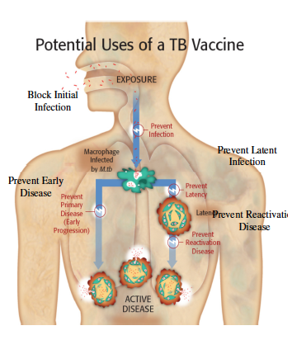
Strategies for TB Vaccine Development
Pre-infection: to prevent infection
Either initial infection or establishment of the granuloma
Post-infection: to prevent disease
after initial infection (most animal data to date)
reactivation from latency (minimal animal data)
Immunotherapeutic: treatment
Shorten the course of chemotherapy for active TB
Decrease relapse or reinfection rates (may correlate to latency)

Slide 13
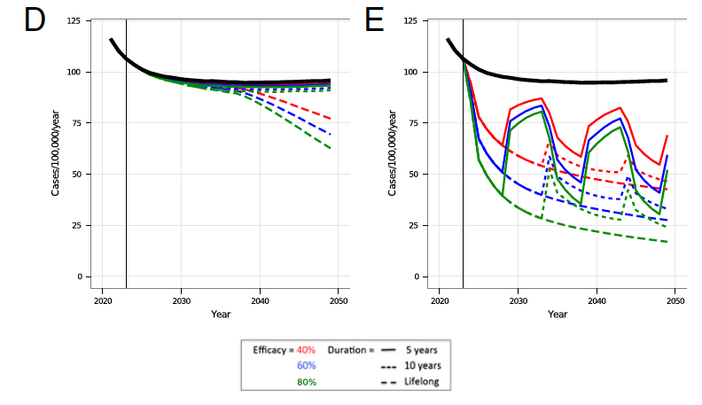
Vaccine
Adult vaccine strategy (40% VE and 5-year protection) greater impact on TB incidence than infant vaccine (80% VE and lifelong protection) by 2050
development: background
Modeled impact of a new TB vaccine targeted at
infants (D) or adolescents/adults (E)
Adult vaccine likely to
prevent more infant TB
cases than an infant
vaccine
– due to reduction in
transmission
Knight, PNAS 2014
*waves = mass
campaigns

Slide 14
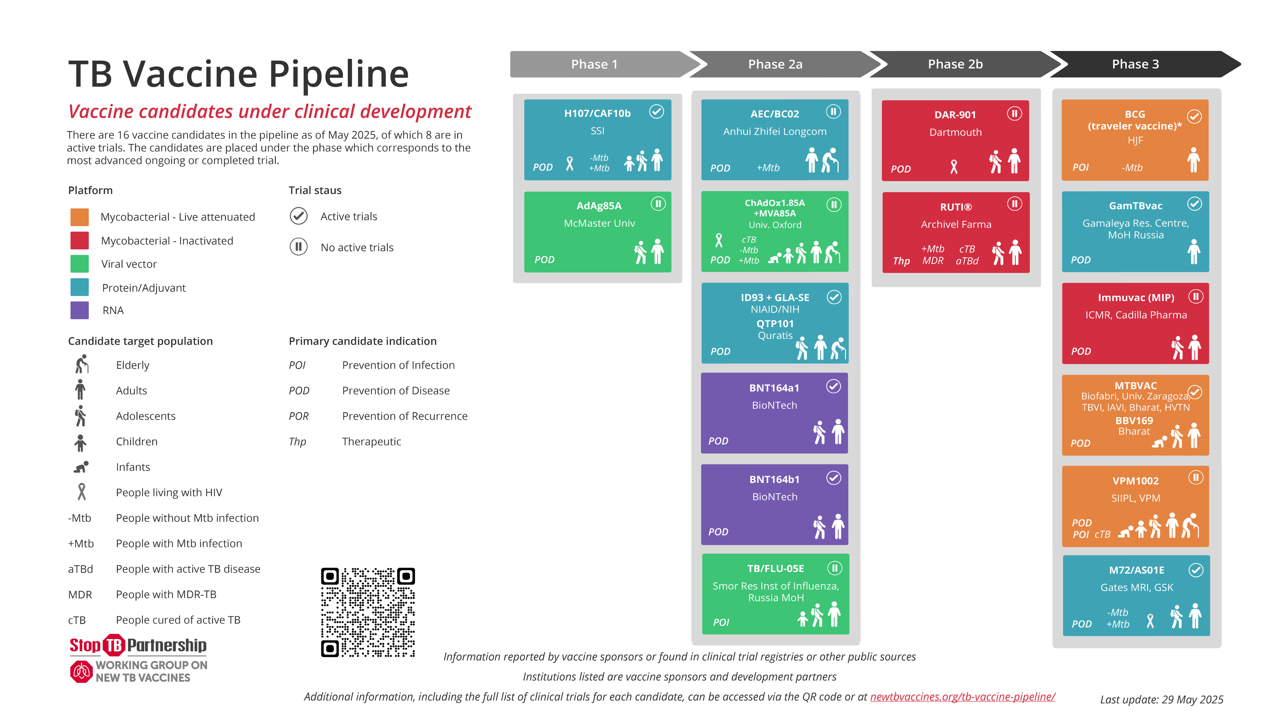

Slide 23
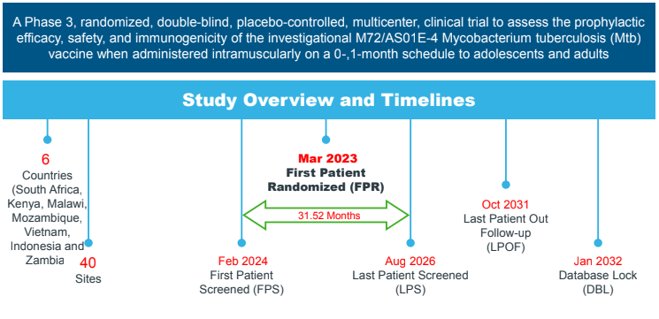
*End of Trial = when at least 110 cases of laboratory-confirmed PTB have accrued in the primary analysis set for efficacy in the IGRA+Cohort
Kenya, recruitment started in July 2024. There are eight sites;
KEMRI/CRDR - Nairobi
KEMRI –Mtwapa
KAVI- Institute of Clinical Research - Nairobi
CREATES, Strathmore University
Victoria Biomedical Research Institute
Pwani Research Centre Ganjoni Dispensary
Clinical Research Health Network (CREA-N) – Machakos
KEMRI Walter Reed Project – Kericho

Slide 24
Other TB vaccine trials conducted/Planned
Aeras 402-Adenovirus 35 vectored vaccine for prevention of disease in BCG vaccinated infants- Siaya- phase 2 B -2013
Failed Immunogencity
VPM1002- Recombinant BCG vaccine trial in infants for prevention of infection ( completed enrollment and follow up)
VPM1002 was inferior to BCG in prevention of infection
MTBVAC- Attenuated MTB for prevention of disease- study planned for 2025

Slide 25
Lessons Learned
Epidemiological evidence of disease burden critical to justifying site selection for clinical trials
Large scale vaccine trials great for resourcing sites and creating sustainment
The infrastructure needed can be accrued gradually and help bring multiple concepts together to achieve excellence:
GCP compliant pharmacy
High quality processing of samples, storage and capacity for shipping
Good community relationships that lead to rapid enrolment and high retention
Good will that leads to building trust with communities
Trials are magnates for each other, the more studies we do the more we attract more
Long term staff retention critical for success and retention of knowledge/skills

Slide 26
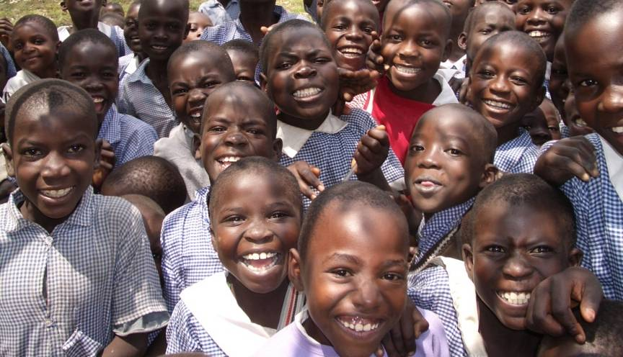
Thank you

